Slide 1
Mirror++
Qurrat Ulain and Annoor Rahman

Slide 2
Project Introduction
Smart mirror aimed toward people with different forms and levels of disabilities.
Perform operations based on gestures and voice control, depending on user preference.
It will extend functions already available on smart devices and make them more accessible.
It will also be able to automate existing IoT devices like lights and outlets.

Slide 3
Business Need / Opportunity
Market for people that unable to utilize smart assistants such as Google Assistant, Amazon Alexa or Apple’s Siri
Device that can replicate some of the smart assistant features using gestures while also maintaining the voice command features of original smart devices.
The device can also be used by people who simply want a smart mirror that they can obtain data and automate things with.

Slide 4

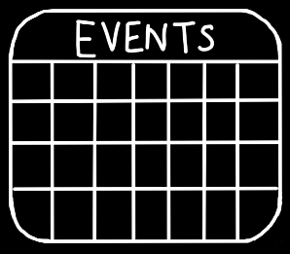
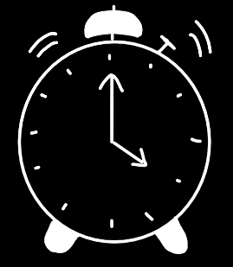

Widgets and their Purpose
Simple widgets that are a staple for smart devices, allow users to plan ahead for their day accordingly
Customizable (flashing vs noise) Useful for people if they need something that is eye catching and brightens up the room, and also isn’t easy to snooze
Ease of use, can control devices while getting dressed with a simple command or gesture

Slide 5
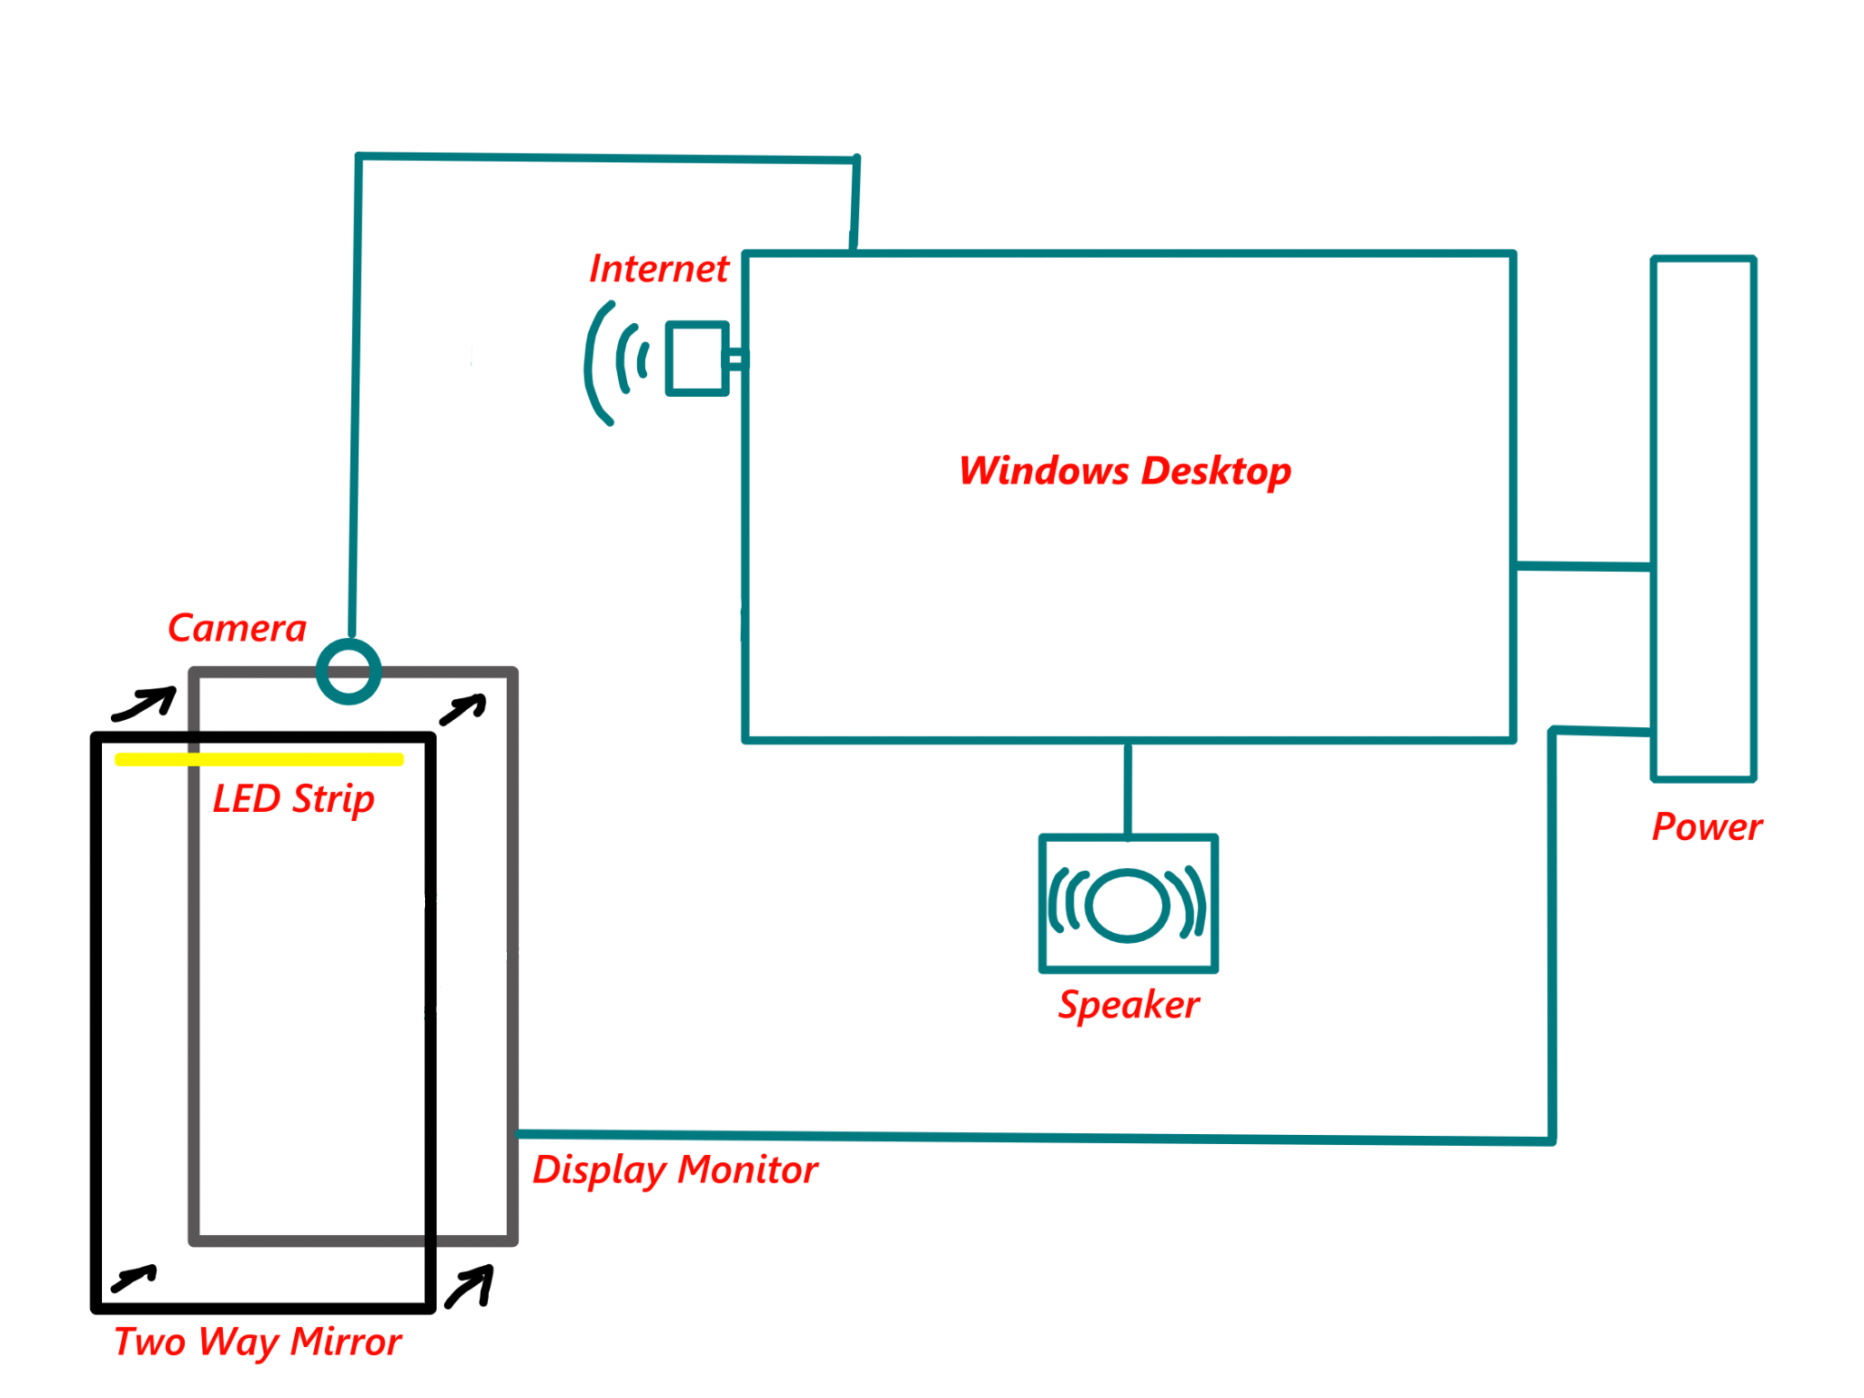
System Design

Slide 6






Technology Used
Kivy
Google Calendar API
OpenCV
OpenWeatherMap API
MediaPipe
SpeechRecognition
Python

Slide 7
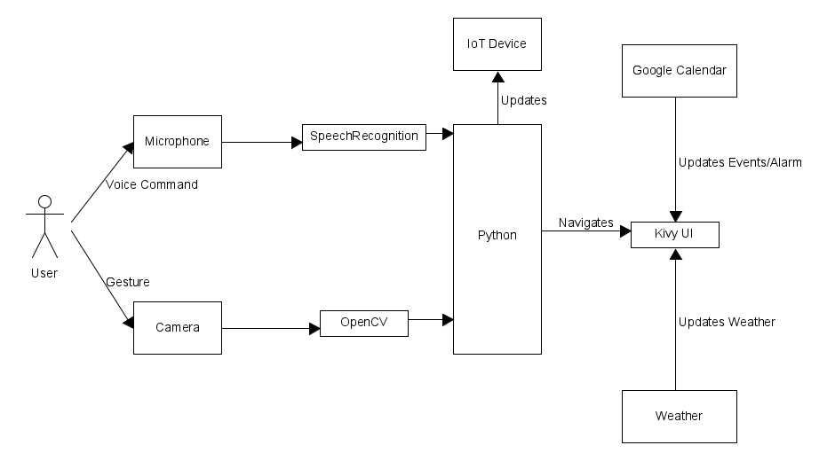
System Architecture

Slide 8
List of Gestures and Commands
Gestures
Voice Commands
Use your palm as a cursor
Close palm to select using cursor
Peace sign to go to the home page
Point left from home to get to main menu
Start commands with “Mirror + command”
Navigate pages by simply stating them
Control on/off devices using “Toggle + device”
“Turn On/Off Gestures”
“Screen off”

Slide 9
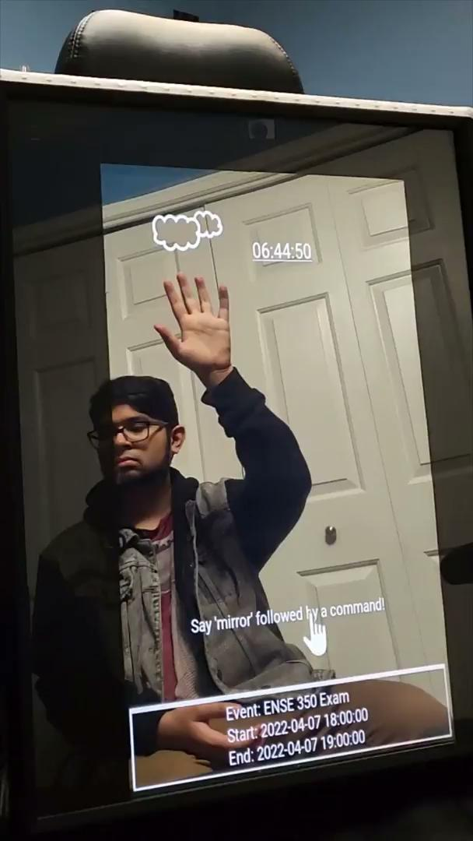
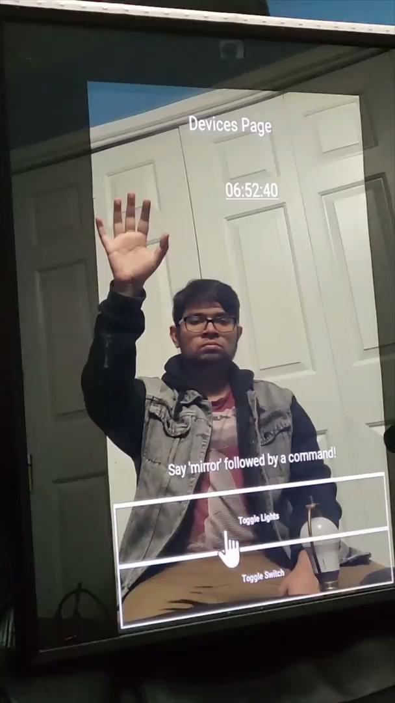
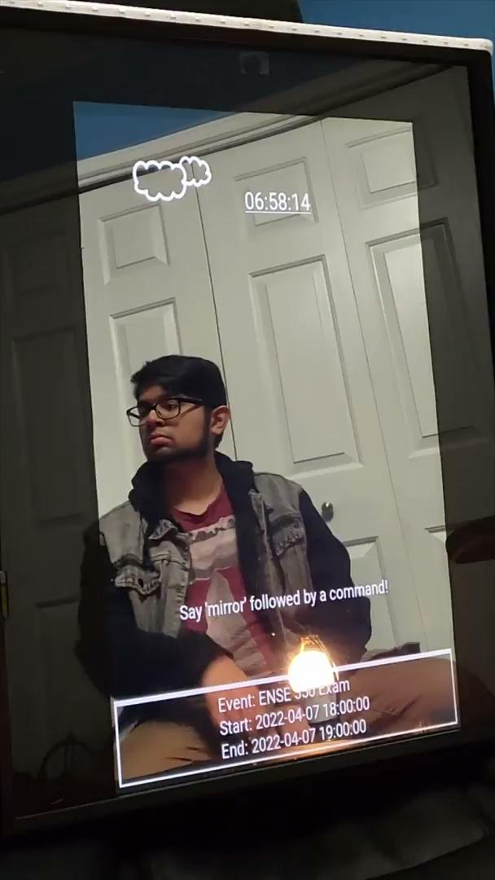
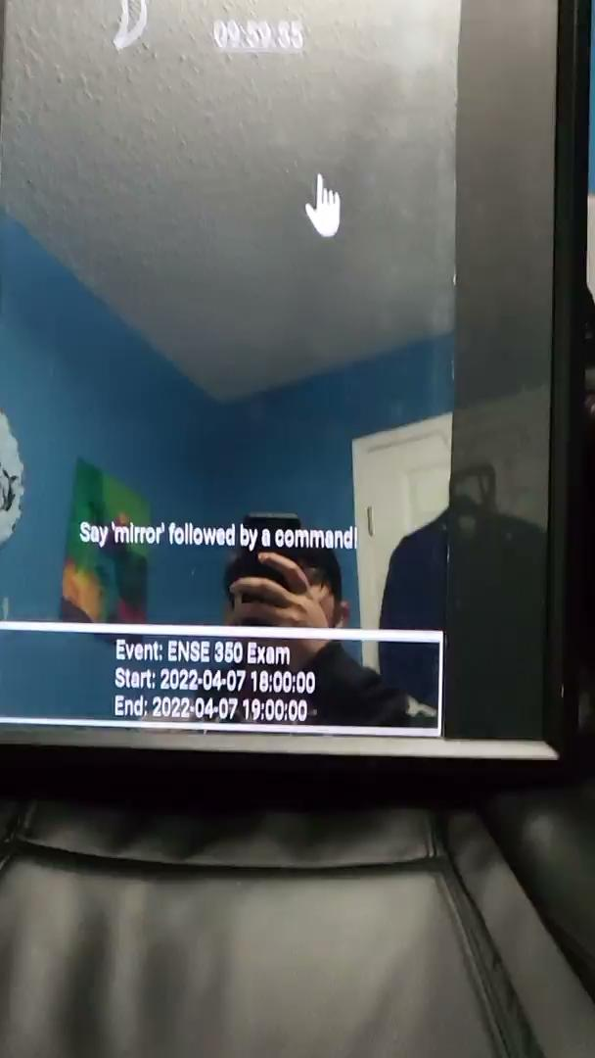
Live Demo / Videos

Slide 10
Future MVPs
Have higher quality hardware components such as microphones, cameras
Add companion application on smartphone for easier IoT device integration
Add security camera integrations

Slide 11
ANY QUESTIONS?

